Slide 1
Real-time SLAM Pipeline in Dynamic Environment
Lingjie Kong, Alex Fu
Stanford University
CS231A, 06/07/17

Slide 2


Problem Definition
Simultaneous Localization and Mapping (SLAM) is the computational problem of constructing or updating a map of an unknown environment while simultaneously keeping track of an agent's location within it
Two approaches:
Recursive Bayesian Estimation
Optimization Approach
Challenge: Non static environment continues to present research challenge.

Slide 3

Motivation, Previous work, and Outline
Motivation:
Extend the SLAM setting to dynamic environment.
Present a real-time SLAM pipeline which takes in the video frames as input, and gives the 3D reconstructed scene as the output.
Previous work:
SLAM with DATMO (Detection and Tracking of Moving Objects) [1]
Outline:
YOLO Object Detection
GrabCut image Segmentation
RGB-D 3D static scene reconstruction
[1] Online Simultaneous Localization And Mapping with Detection And Tracking of Moving Objects: Theory and Results from a Ground Vehicle in Crowded Urban Areas

Slide 4
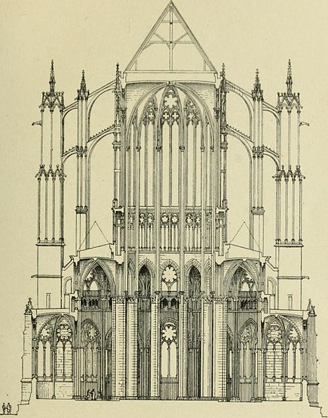
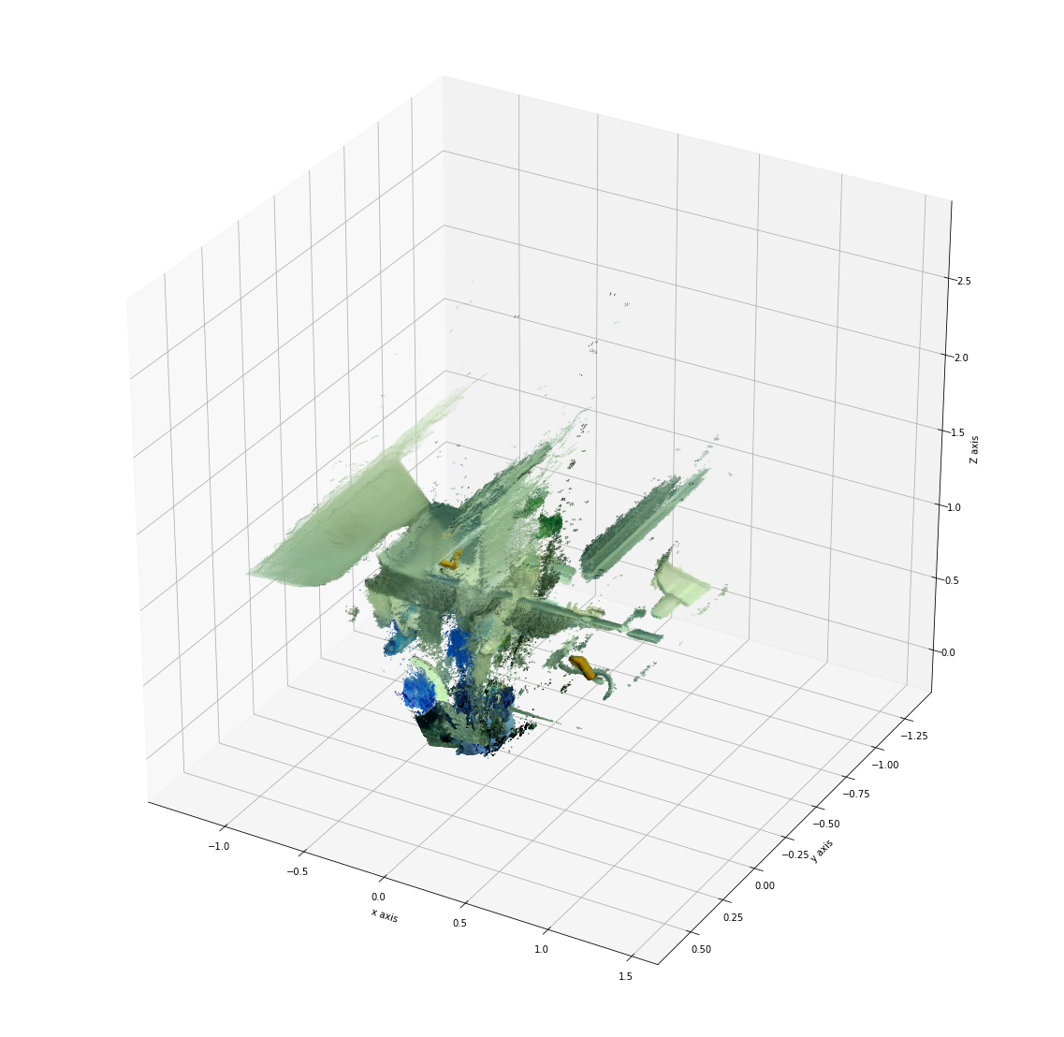
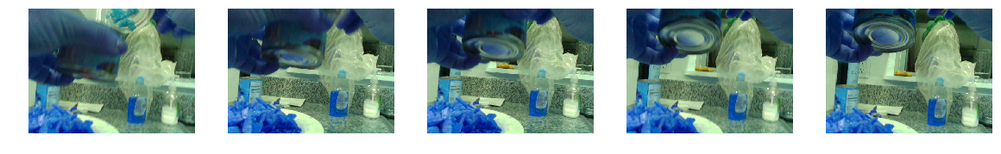
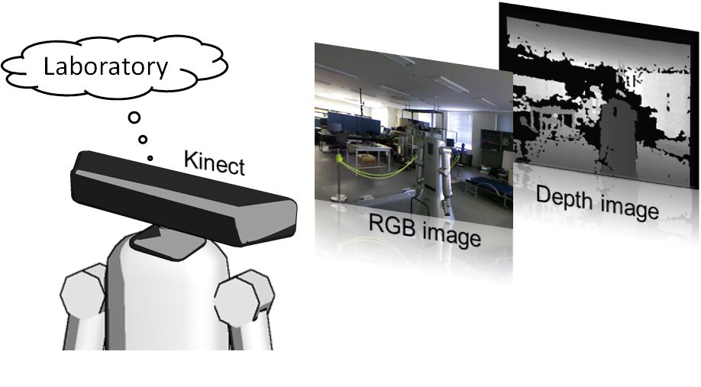
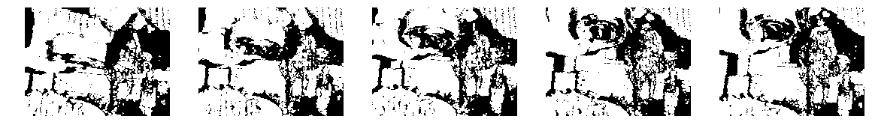
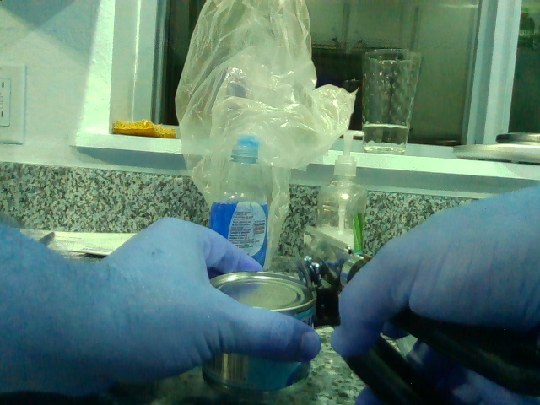
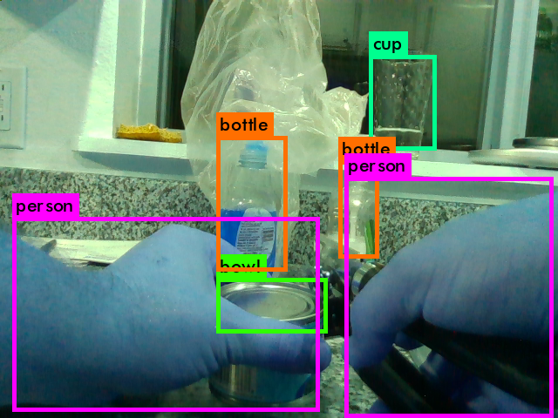
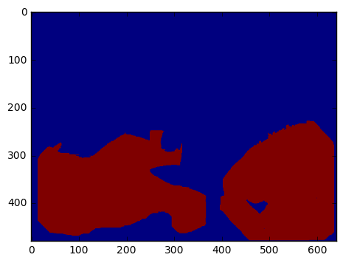
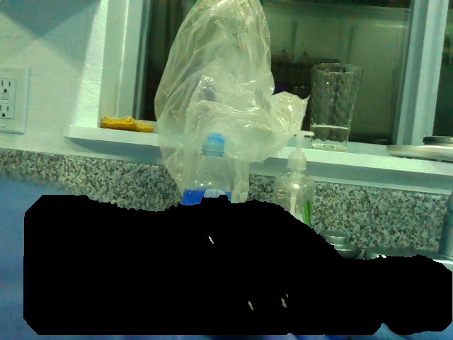
Architecture
RGB-D Camera
Video Frames
3D scene without Dynamic object
One RGB Frame
Object Detection
Segmentation
RGB Filtered Frame

Slide 5

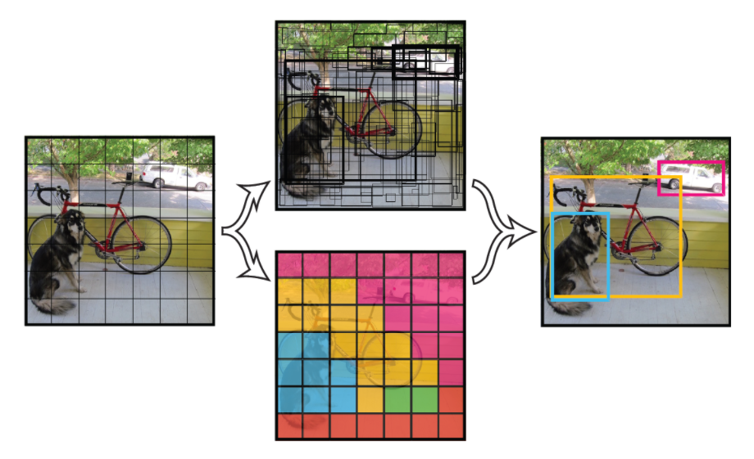
YOLO (You Only Look Once) [2]
Pipeline:
Details:
Split image to grid
Predict bounding box location and confidence
Non-Maximum Suppression (NMS) for low score bounding box
[2] YOLO9000: Better, Faster, Stronger

Slide 6

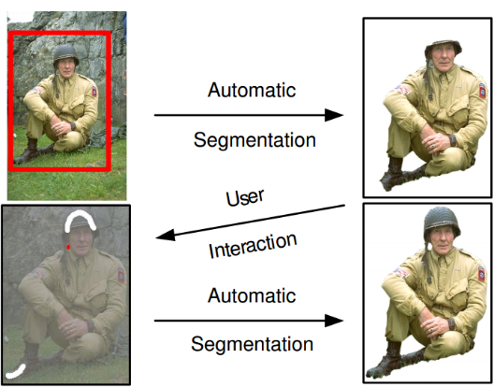
GrabCut Image Segmentation [3]
Pipeline:
Details:
Iterative algorithm with Gaussian Mixture Model (GMM) IID
EM algorithm to find the best fit to segment the foreground and background
[3] “GrabCut” — Interactive Foreground Extraction using Iterated Graph Cuts

Slide 7
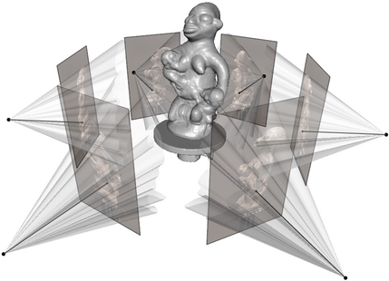
RGB-D 3D Reconstruction [4]
Goal: Find the Camera Pose (Transformation Matrix)
Pipeline: Optimization approach
Photometric Error
Error of pixel intensity from one frame to another
Depth error
Error of depth information from one frame to another
Algorithm:
Find the best camera pose between two frames to minimize the sum of these two errors.
[4] Dense Visual SLAM for RGB-D Cameras

Slide 8

Result

Slide 9
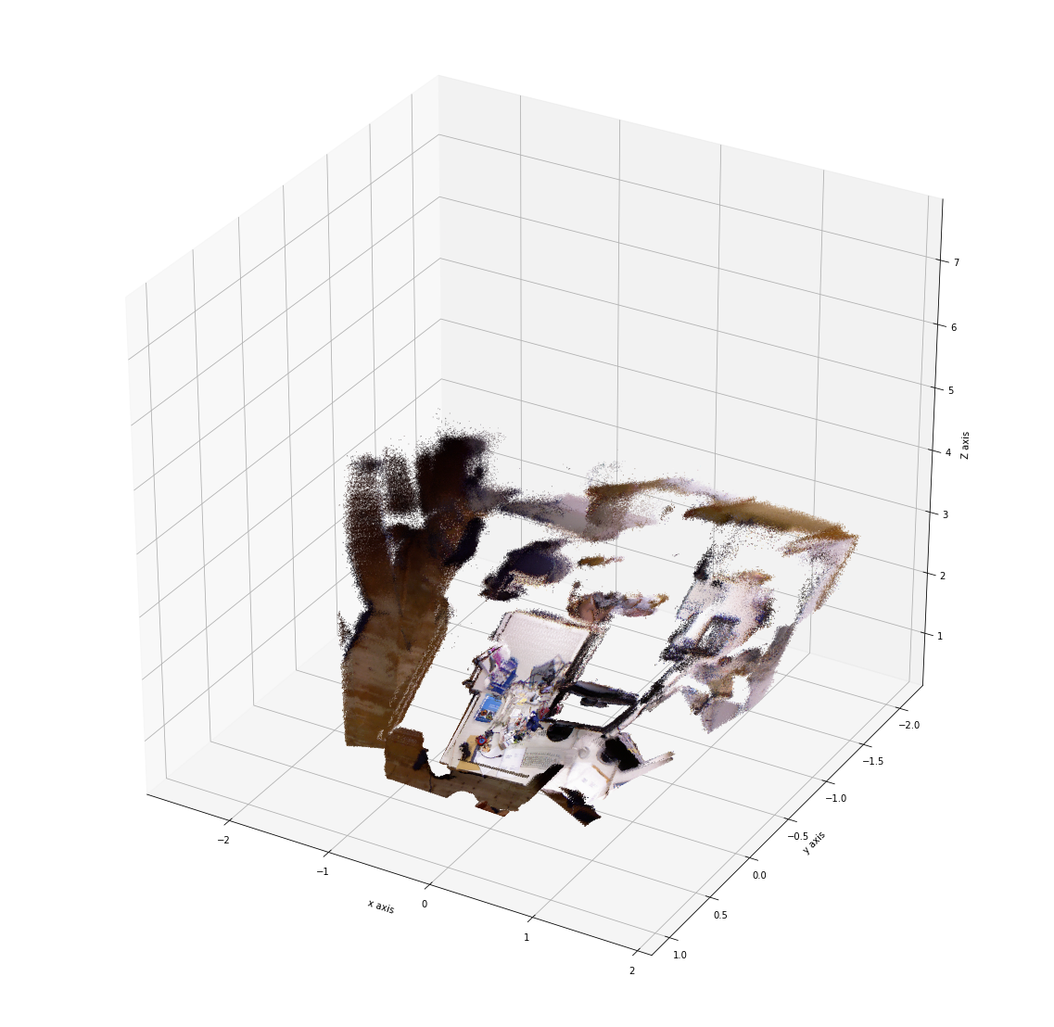
Result

Slide 10

Future Work
Enhance the object detection accuracy by trying R-CNN object detection
Analyze the dynamic object by using RNN
Speed up the algorithm because running the whole pipeline now takes around one hour

Slide 11
Question?

Slide 12

Thank you!

